Slide 1


Andrew Gomoll
December 2022

Slide 2

Outline
Executive Summary
Introduction
Methodology
Results
Conclusion
Appendix

Slide 3
Executive Summary
Summary of methodologies
Data was accessed using standard extraction techniques
Trends were explored using wrangling and visualization techniques
Summary of all results
Success rates generally improved over time as more launches were conducted

Slide 4

Introduction
In recent years private and public companies have launched into the extra-terrestrial products and travel market creating a commercial space age.
For example, Virgin Galactic has offered some space flights, Rocket Labs provides small satellites, and Blue Origin manufactures reusable rockets.
In the same vein, Space X has sent spacecraft to the international space station as well as other manned missions to space.
Space X has been able to execute more launches than other providers as their signature rockets are reusable, allowing for relatively inexpensive missions.
Advertised at $62 million per launch, the Space X missions undercut competing providers with more expensive launches at $162 million.
This analysis aims to more accurately predict the price of each launch using data wrangling, analysis, and machine learning to predict the reusability of Space X rockets.

Slide 5

Section 1

Slide 6
Methodology
Executive Summary
Data collection methodology:
Describe how data was collected
Perform data wrangling
Describe how data was processed
Perform exploratory data analysis (EDA) using visualization and SQL
Perform interactive visual analytics using Folium and Plotly Dash
Perform predictive analysis using classification models
How to build, tune, evaluate classification models

Slide 7
Data Collection
Data was collected using several methodologies
Get request to Space X API
Web scraping Space X records from Wikipedia
Connecting to a database to extract CSV files

Slide 8
Data Collection – SpaceX API
First, data was collected by by sending a request to the Space X API to collect data. The data was then cleaned and formatted for use.
The API response was sent as a json containing a large volume of data. From this data, variables were created to list of information of interest and then converted to a pandas DataFrame.
The data was then filtered to focus on Falcon9 launches and eliminate missing data.
https://github.com/agomoll/Space_X_Analysis/blob/master/jupyter-labs-spacex-data-collection-api.ipynb
Place your flowchart of SpaceX API calls here

Slide 9
Data Collection - Scraping
Second, launch data was collected by scraping wiki Space X records from the web using Beautifulsoup.
The data was then parsed into a dictionary and then stored in a Pandas DataFrame.
https://github.com/agomoll/Space_X_Analysis/blob/master/jupyter-labs-webscraping.ipynb
Place your flowchart of web scraping here

Slide 10
Data Wrangling
Data processing:
Calculate the percentage of the missing values in each attribute
Identify the datatype of each attribute
Calculate the number of launches on each site
Calculate the number of launches to each orbit level
Calculate the number of outcome types
Create Outcome Classification column for successful (1) and unsuccessful (0) classifiers
Determine Success Rate
https://github.com/agomoll/Space_X_Analysis/blob/master/labs-jupyter-spacex-Data%20wrangling.ipynb

Slide 11
EDA with Data Visualization
Summary of plotted charts:
Flight number vs Launch Site scatter plot
Payload vs Launch Site scatter plot
Success Rate vs Orbit Type bar chart
Flight Number vs. Orbit Type
Payload vs Orbit Type
Launch Success yearly trend
https://github.com/agomoll/Space_X_Analysis/blob/master/jupyter-labs-eda-dataviz.ipynb

Slide 12
EDA with SQL
Summary of SQL queries:
Display unique launch sites
Display Launch sites beginning with ‘CCA’
Display total mass carried by NASA (CRS)
Display average mass carried by booster version F9 v1.1
Display date of first successful landing on a ground pad
List names of boosters with success landing on drone ships with payload greater than 4000kg but less than 6000kg
Display the total number of missions, both success and failures
List the booster versions that have carried the max payload mass
List the records which will display the month names, failure landing outcomes in drone ship ,booster versions, launch site for the months in year 2015
Rank the count of successful landing outcomes between the date 04-06-2010 and 20-03-2017 in descending order.
https://github.com/agomoll/Space_X_Analysis/blob/master/jupyter-labs-eda-sql-coursera_sqllite.ipynb

Slide 13
Build an Interactive Map with Folium
To create interactive map experiences, the following features were added to map visualizations using Folium:
Circles – shape and color make it easier to locate on map
Map Labels – show brief description of site name
Popup labels - deploy when site is clicked to better show site info
Launch Markers – color code success or failed stage one landing
Launch site to obstacle lines with calculations – show distance to landing obstacles
https://github.com/agomoll/Space_X_Analysis/blob/master/lab_jupyter_launch_site_location.ipynb

Slide 14
Build a Dashboard with Plotly Dash
Created a web application dashboard using Plotly Dash
Features include:
Drop Down Menu to enable launch site selection
Pie Chart showing total successful launches for all sites
If a specific site is selected the pie chart shows the successes vs failures at that site
Slider bar to further filter by payload
Scatter chart displaying Payload vs Launch Site Success with Booser Versions
https://github.com/agomoll/Space_X_Analysis/blob/master/spacex_dash_app.py

Slide 15
Predictive Analysis (Classification)
Summary of classification model testing:
Create a NumPy array from the target data column ‘Class’ and assign to variable ‘Y’
Standardize the feature dataset using Standard Scalar and assign to variable ‘X’
Use train_test_split() to divide the data into training and testing sets
Test a variety of models predictive ability with the available data
Logistic Regression
Support Vector Machine (SVM)
Decision Tree Classifier
K Nearest Neighbors
https://github.com/agomoll/Space_X_Analysis/blob/master/SpaceX_Machine%20Learning%20Prediction_Part_5.ipynb

Slide 16
Results
Exploratory data analysis results
Interactive analytics demo in screenshots
Predictive analysis results

Slide 17

Section 2

Slide 18
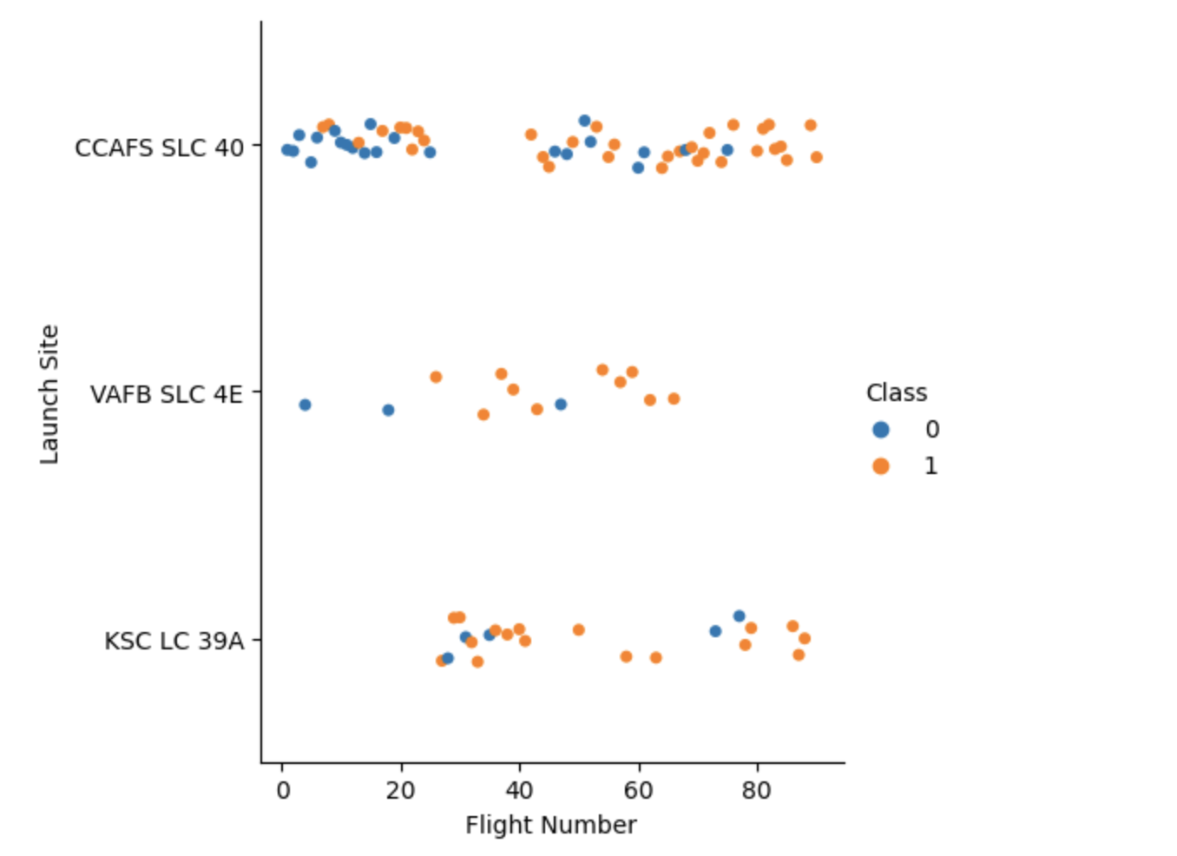
Flight Number vs. Launch Site
It appears that Launch sites VAFB and KSC had higher landing success rates than CCAFS
However, it also appears that landing success at CCAFS improved dramatically in later flights

Slide 19
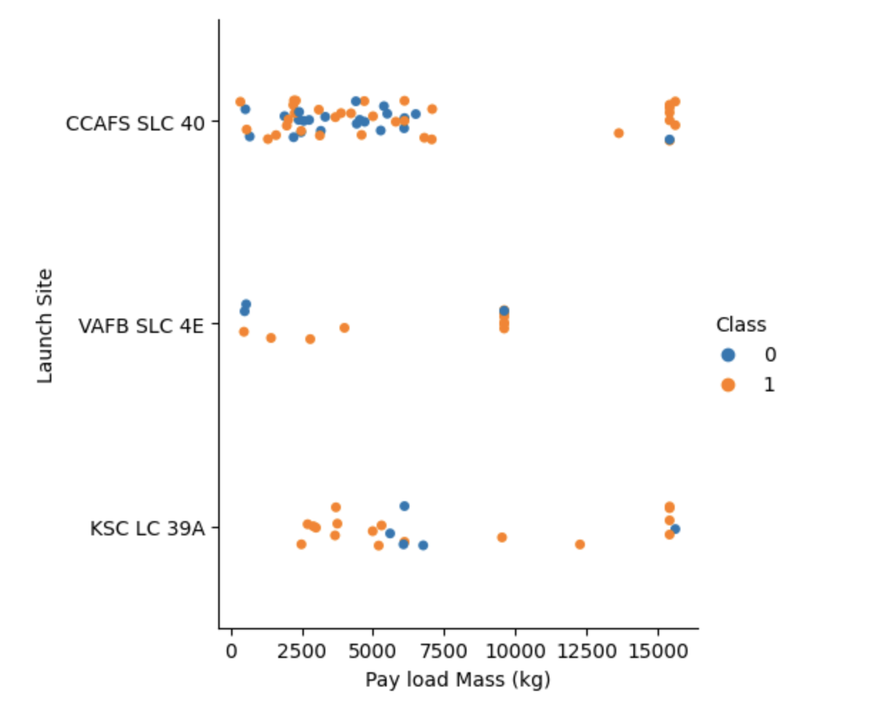
Payload vs. Launch Site
CCAFS had a higher percentage of success with Heavier payloads
VAFB did not have any payloads over 10,000 kg
Successful landing for KSC varied across payloads

Slide 20
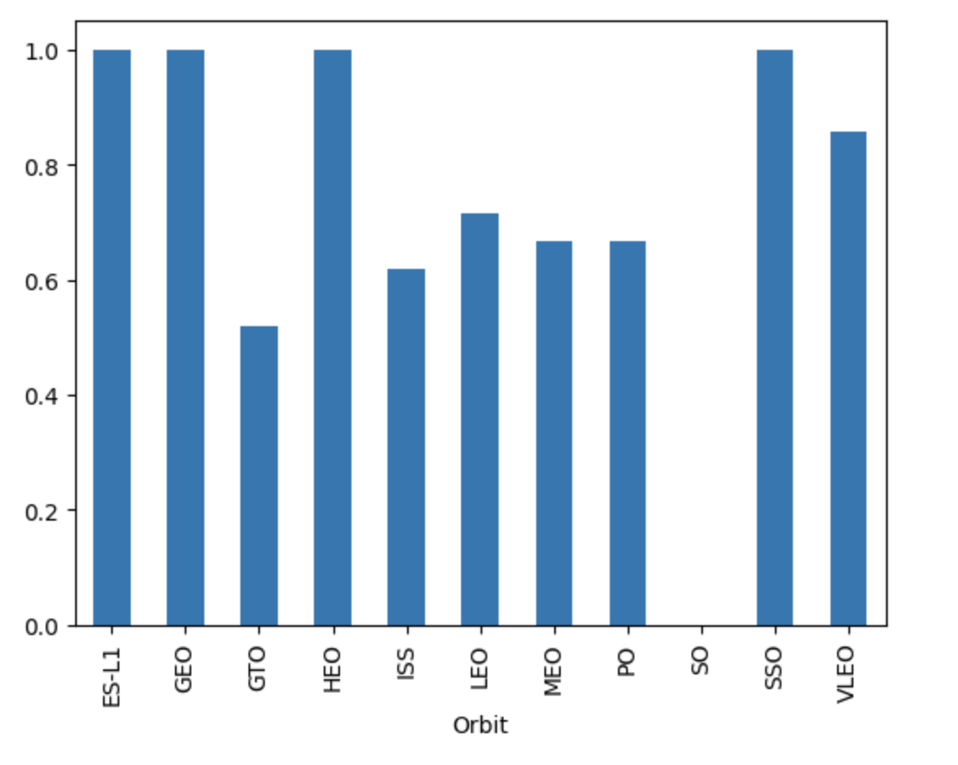
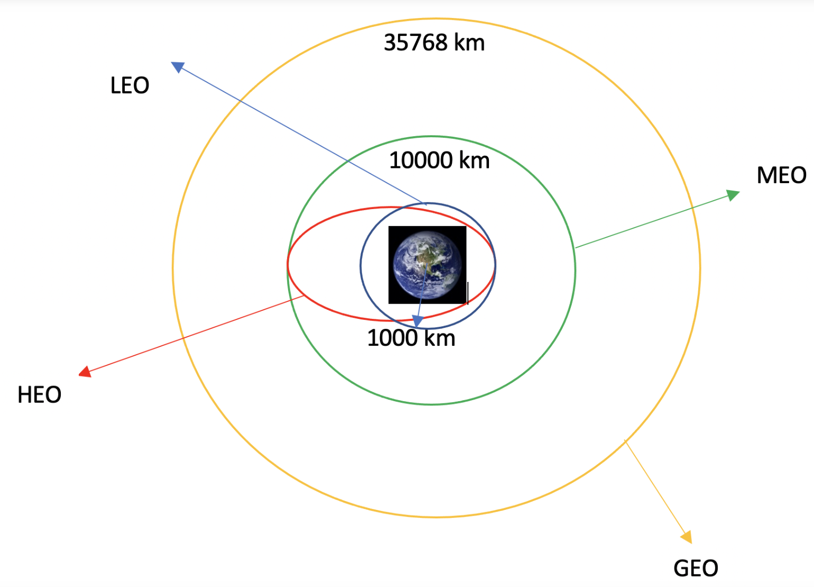
Success Rate vs. Orbit Type
It appears that the highest rates of landing success occurred for launches to:
ES-L1
GEO
HEO
SSO
VLEO
Given the variable nature of these orbits, it is unclear whether a relationship exists

Slide 21
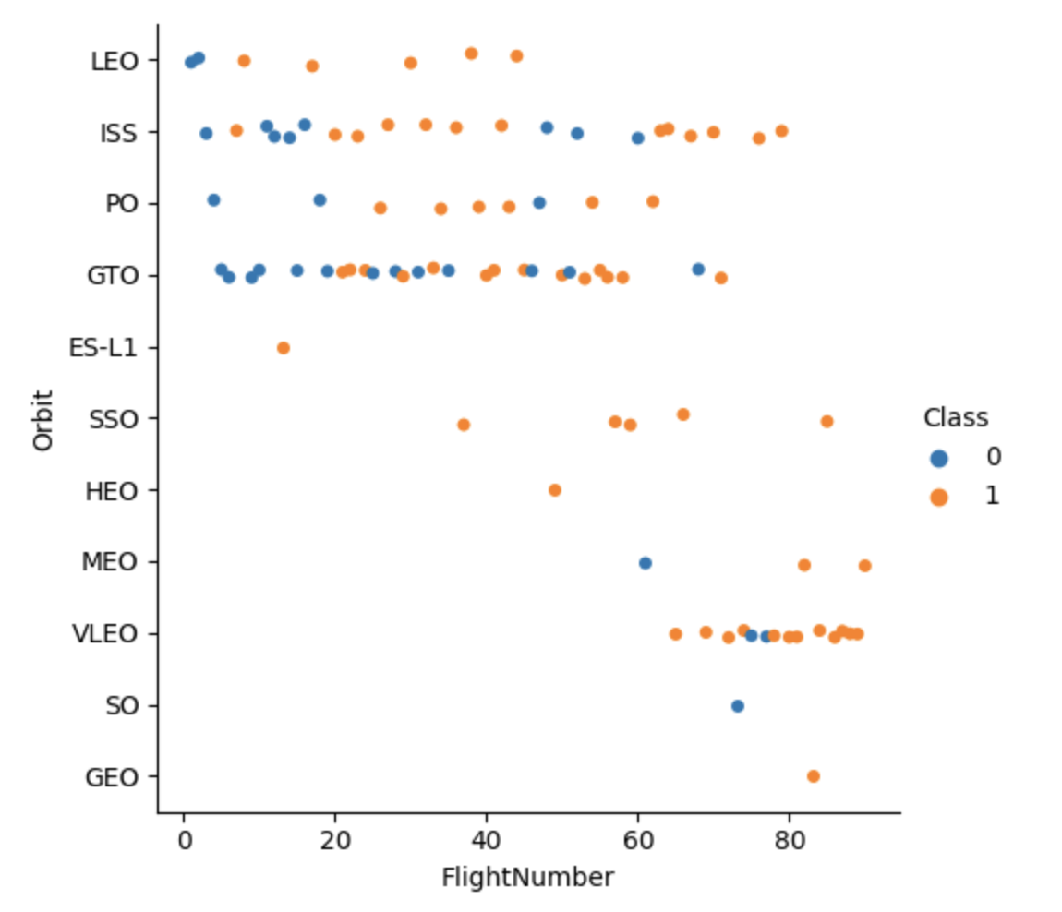
Flight Number vs. Orbit Type
It appears that early flights were focused on LEO, ISS, PO, and GTO orbits with varied success
Later flights explored more orbit types with increasing success

Slide 22
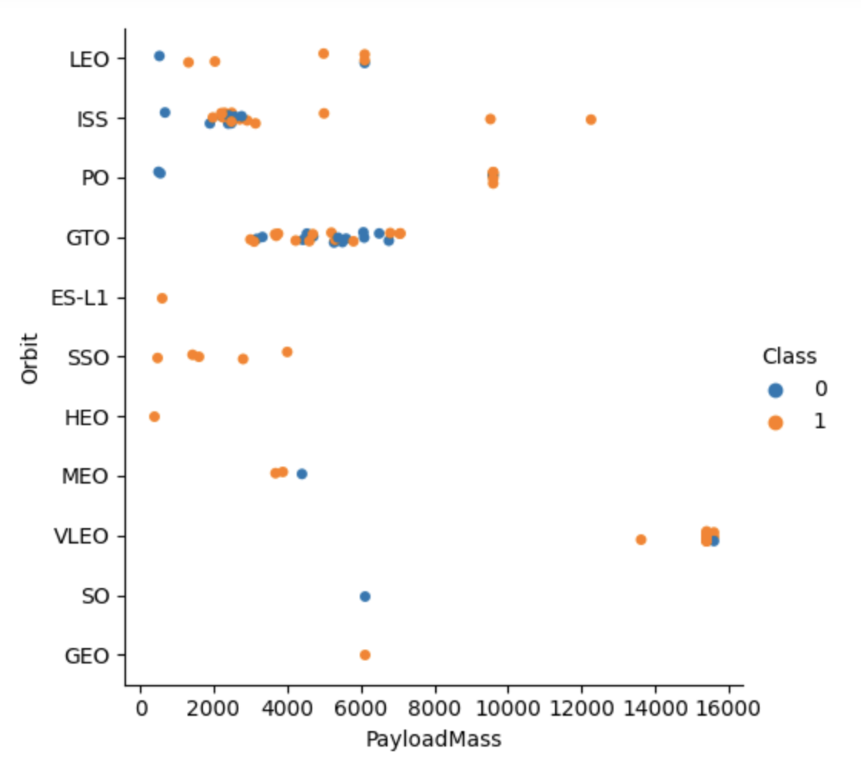
Payload vs. Orbit Type
It appears that lighter payload masses (<10K kg) were the focus of earlier orbit targets.
Later flights had success with heavier payloads, particularly at VLEO

Slide 23
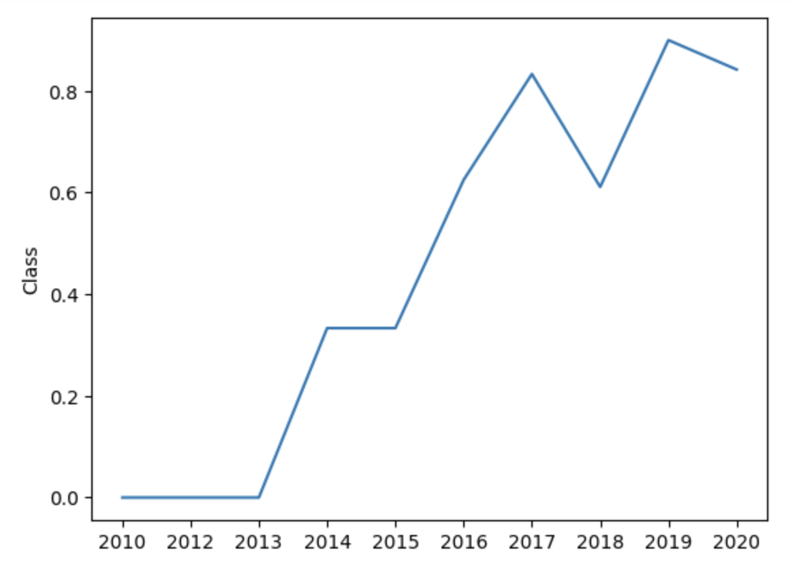
Launch Success Yearly Trend
Overall, the success rate increased since 2013

Slide 24
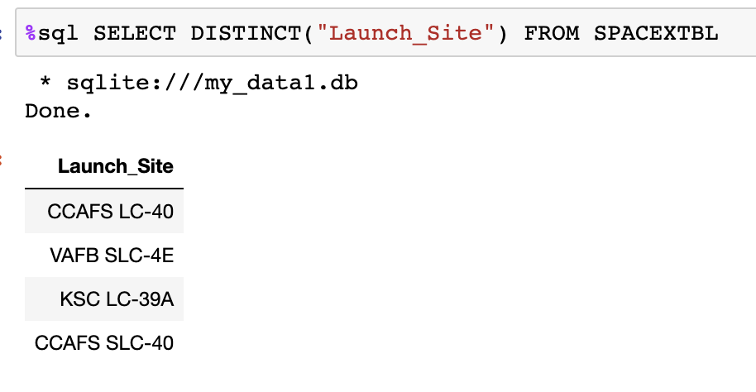
All Launch Site Names
Find the names of the unique launch sites

Slide 25
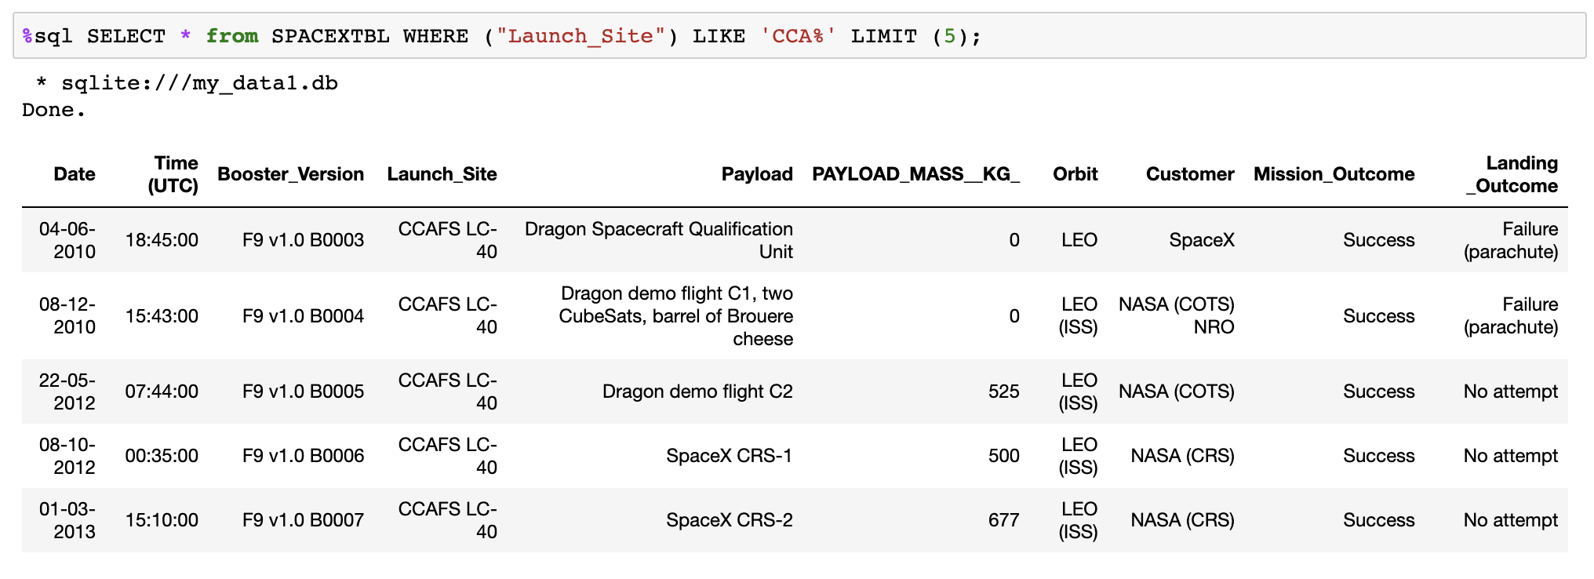
Launch Site Names Begin with 'CCA'
Find 5 records where launch sites begin with `CCA`

Slide 26
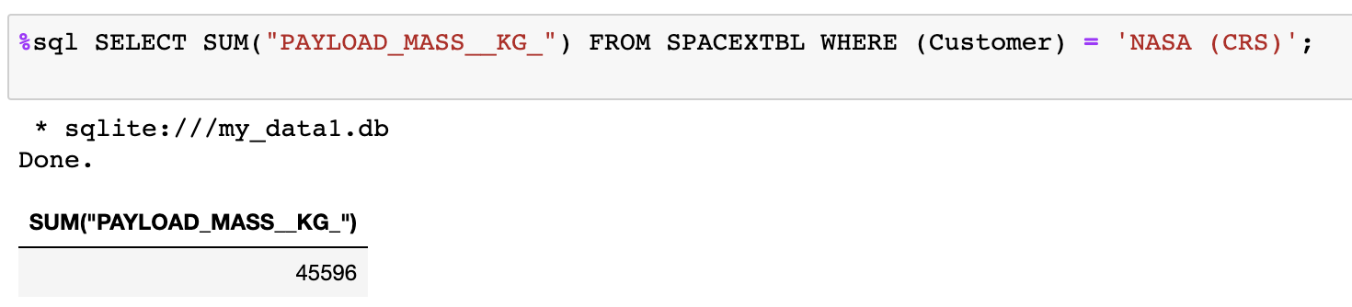
Total Payload Mass
Calculate the total payload carried by boosters from NASA

Slide 27
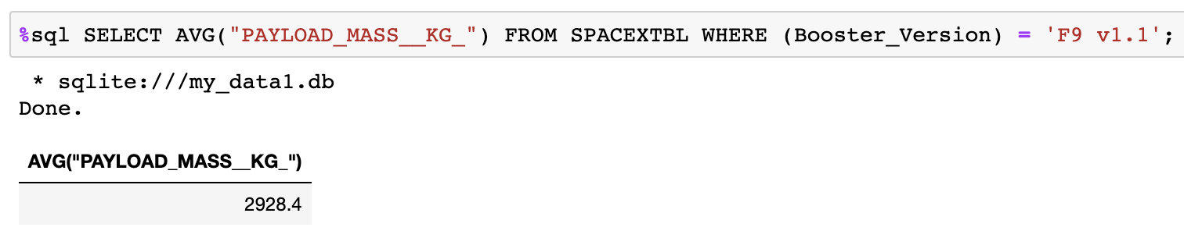
Average Payload Mass by F9 v1.1
Calculate the average payload mass carried by booster version F9 v1.1

Slide 28
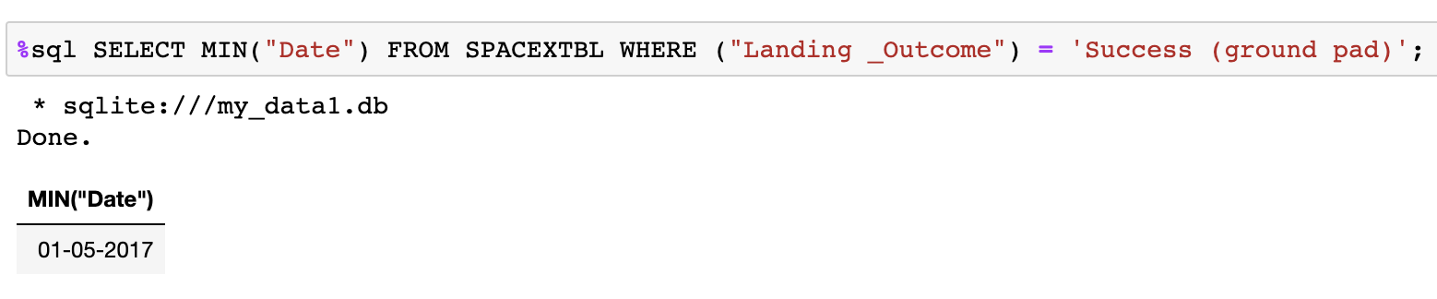
First Successful Ground Landing Date
Find the dates of the first successful landing outcome on ground pad

Slide 29
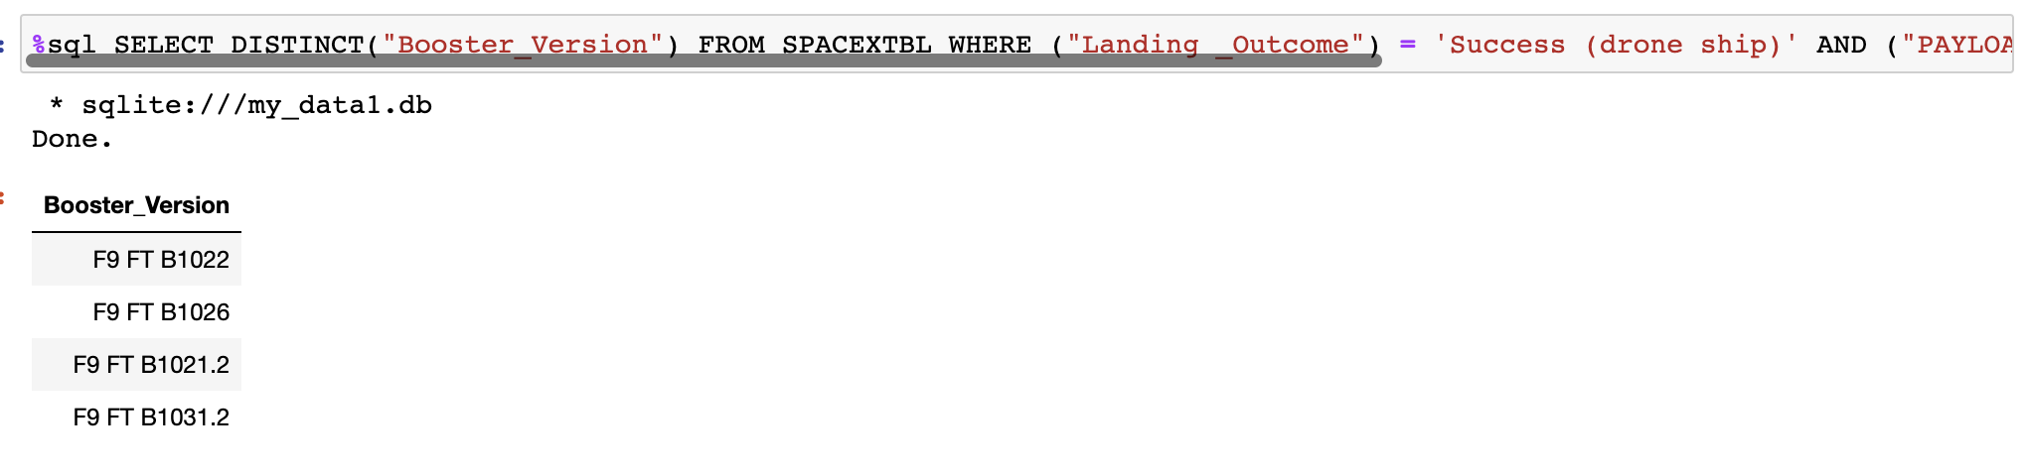
Successful Drone Ship Landing with Payload between 4000 and 6000
List the names of boosters which have successfully landed on drone ship and had payload mass greater than 4000 but less than 6000

Slide 30
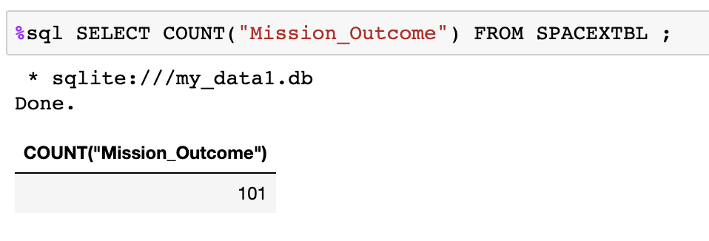
Total Number of Successful and Failure Mission Outcomes
Calculate the total number of successful and failure mission outcomes

Slide 31
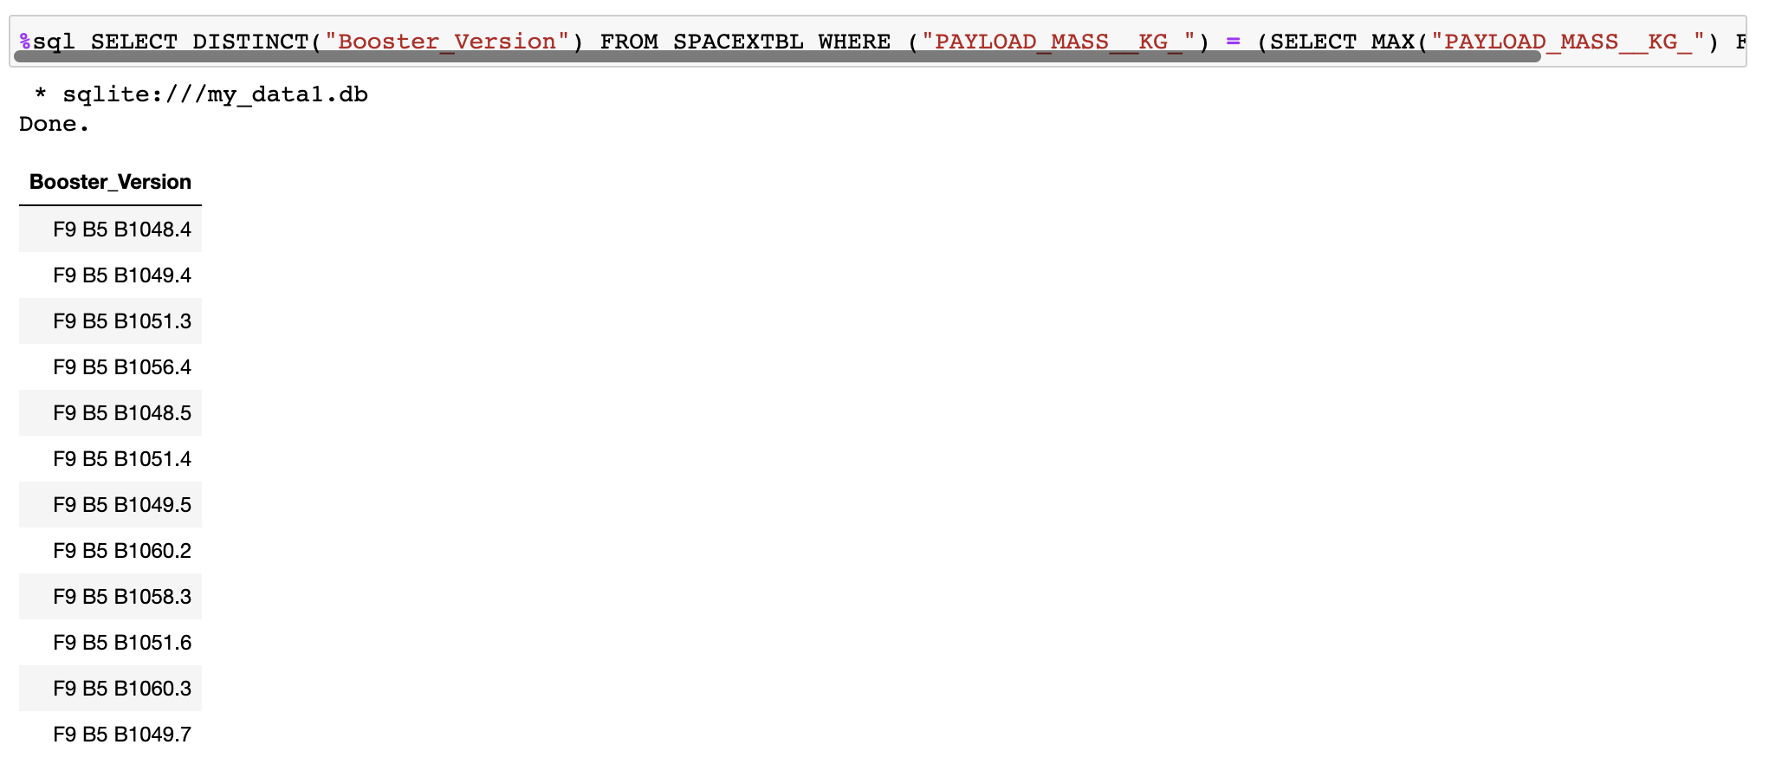
Boosters Carried Maximum Payload
List the names of the booster which have carried the maximum payload mass

Slide 32
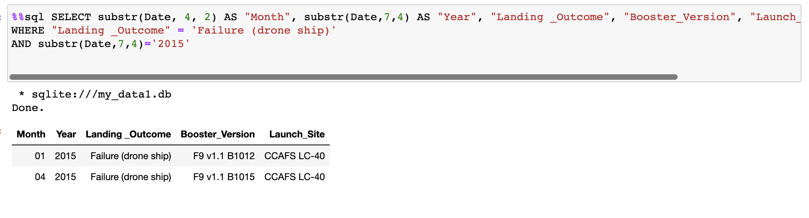
2015 Launch Records
List the failed landing_outcomes in drone ship, their booster versions, and launch site names for in year 2015

Slide 33
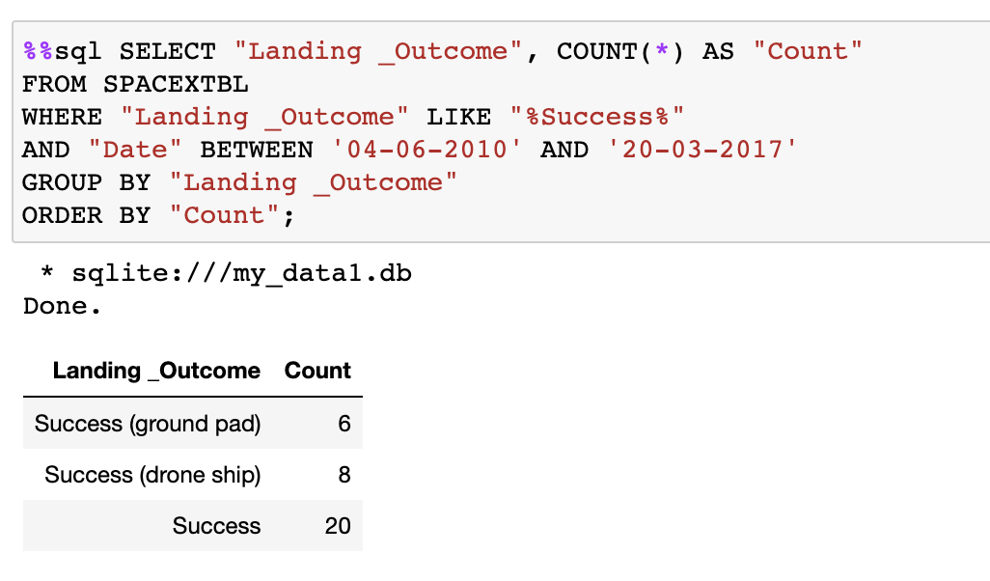
Rank Landing Outcomes Between 2010-06-04 and 2017-03-20
Rank the count of landing outcomes (such as Failure (drone ship) or Success (ground pad)) between the date 2010-06-04 and 2017-03-20

Slide 34

Section 3

Slide 35
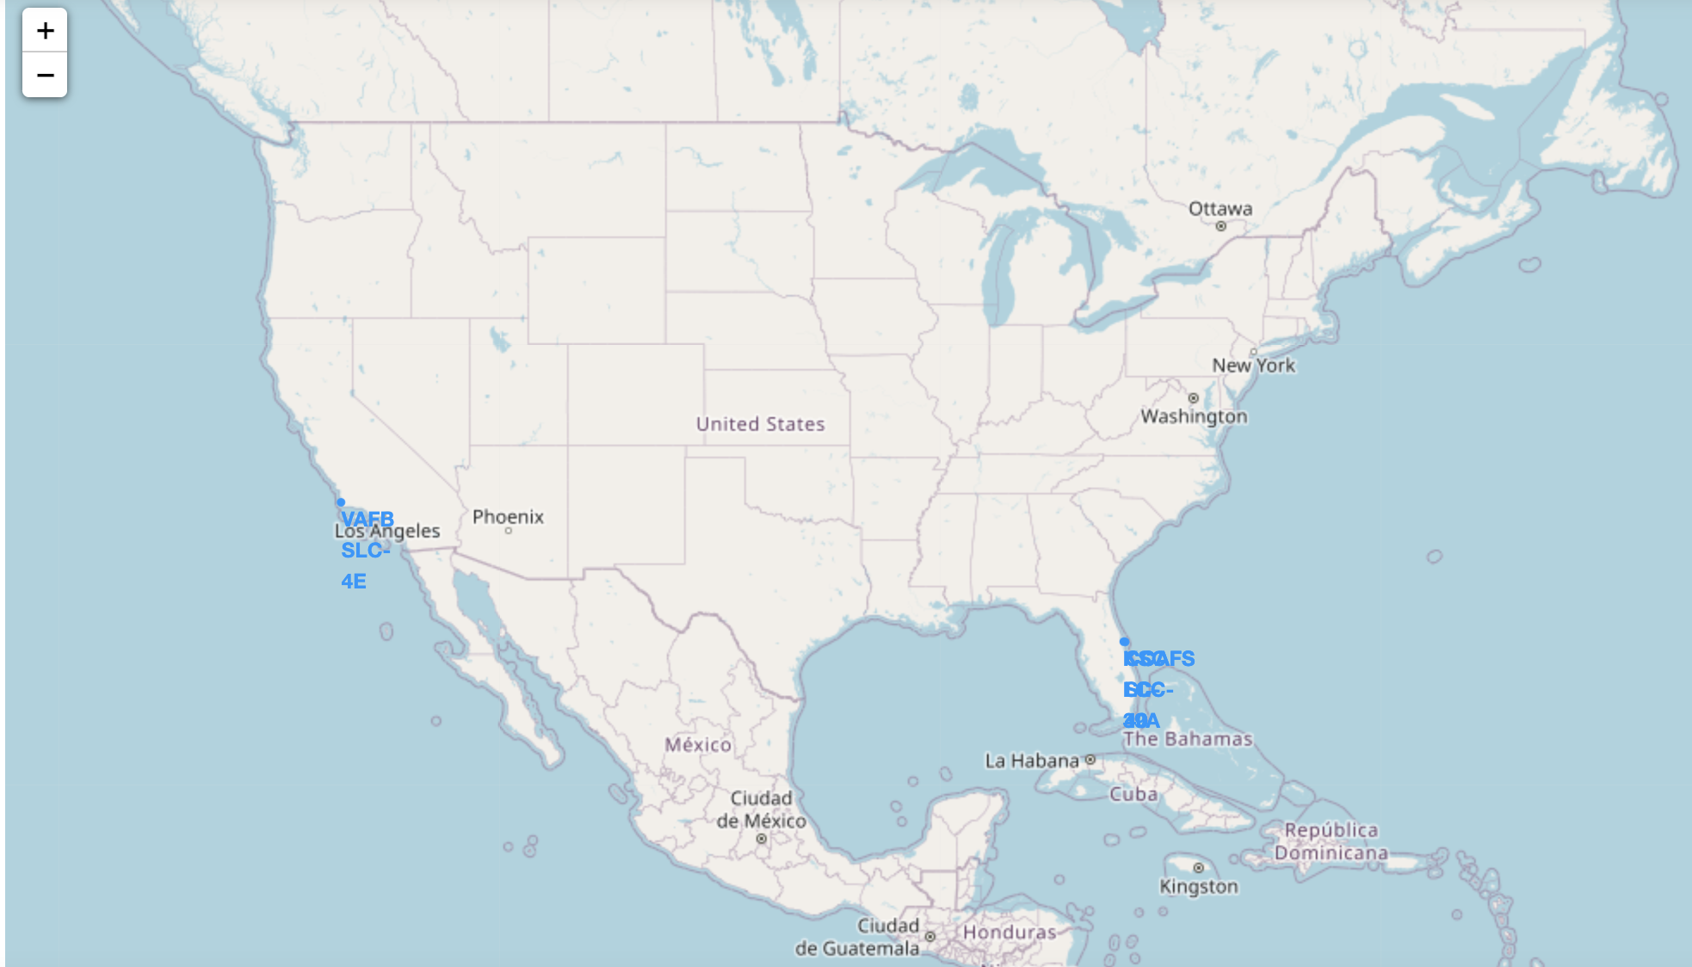
All Launch Site Locations
Launch sites of interest are located in California and Florida

Slide 36
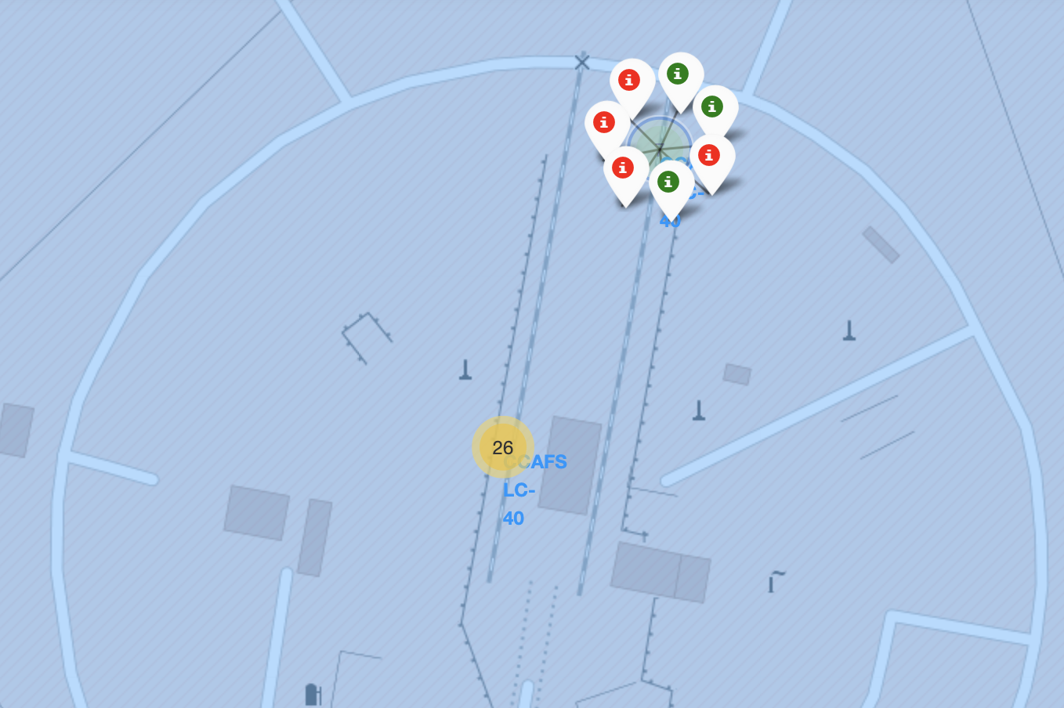
Launch Site Outcome Markers
The display shows a launch site where 3 of the 7 launches had successful landings

Slide 37
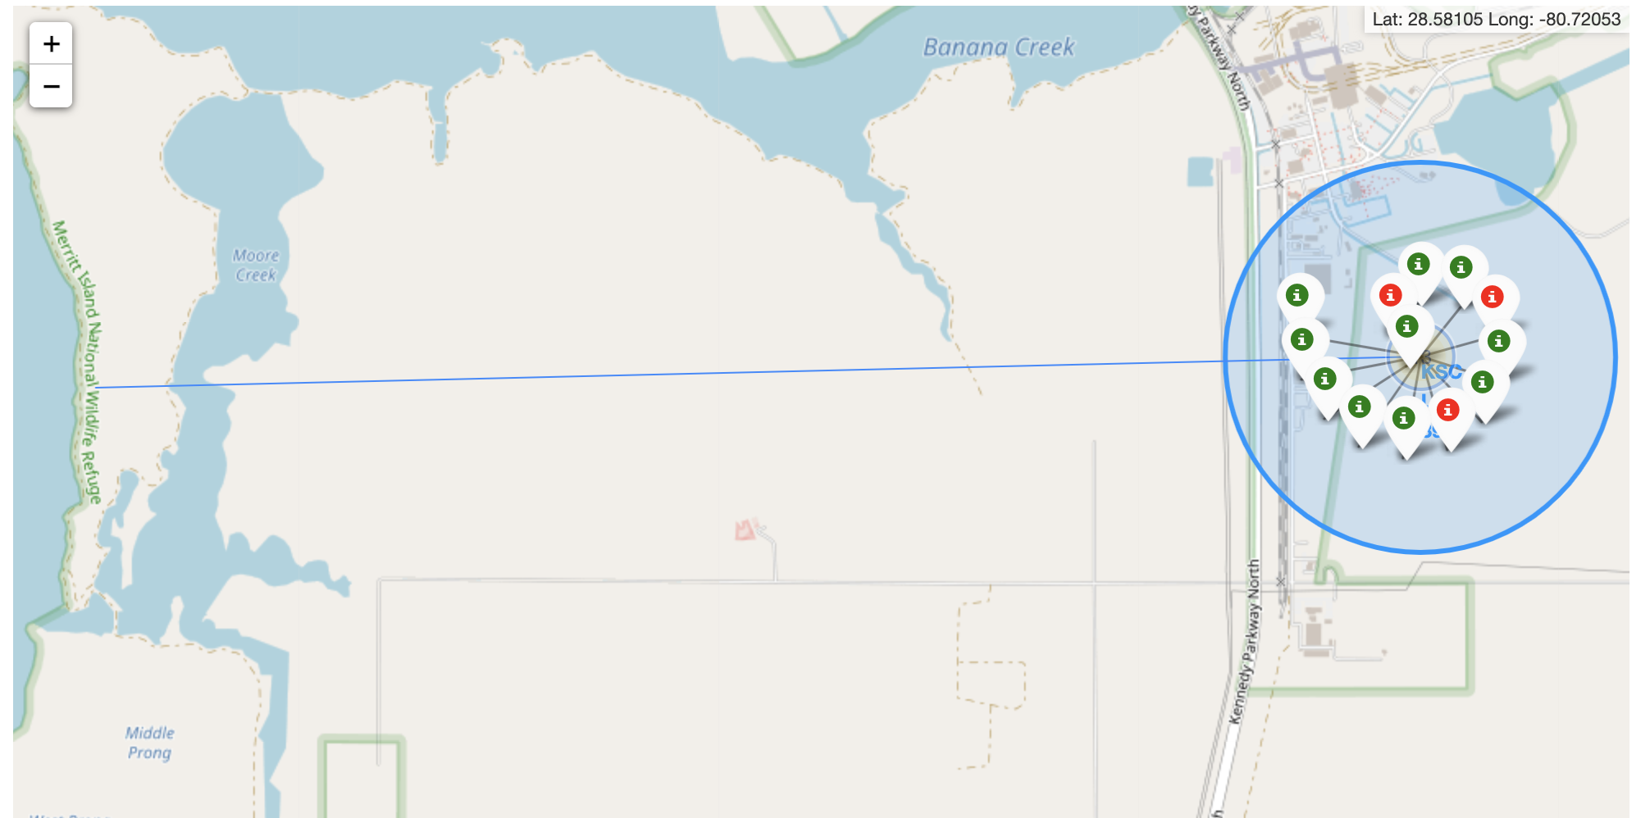
Distance to Proximities
Showing Distance to eastern coastline from Launch Site KSC LC-39A

Slide 38

Section 4

Slide 39
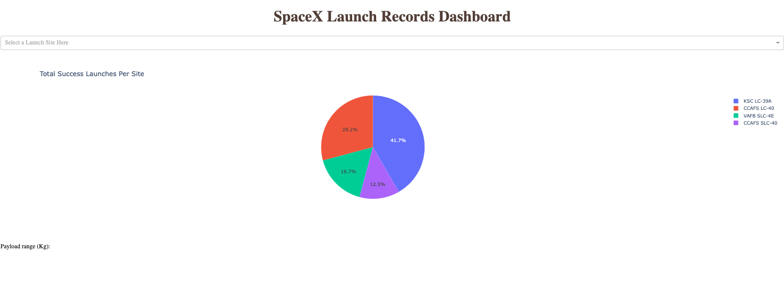
Success Records for All Sites
Across all sites, KSC LC-39A accounted for the highest percentage of successes followed by CCAFS LC-40, VAFB SLC-4E, and CCAFS SLC-40

Slide 40
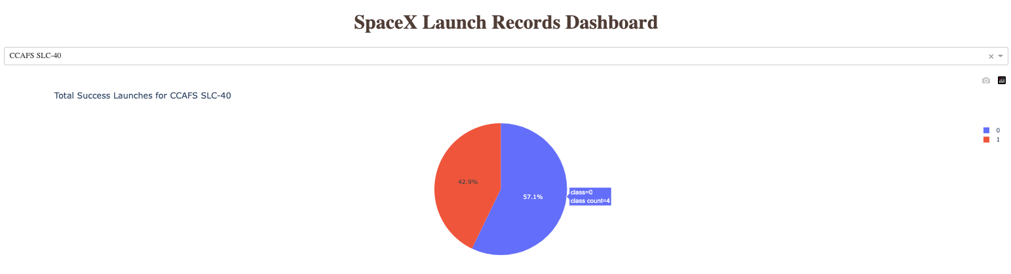
Highest Success Ratio
For Launch Site CCAFS SLC-40, 42.9% of the launches were successful, while 57.1% of the launches were unsuccessful

Slide 41
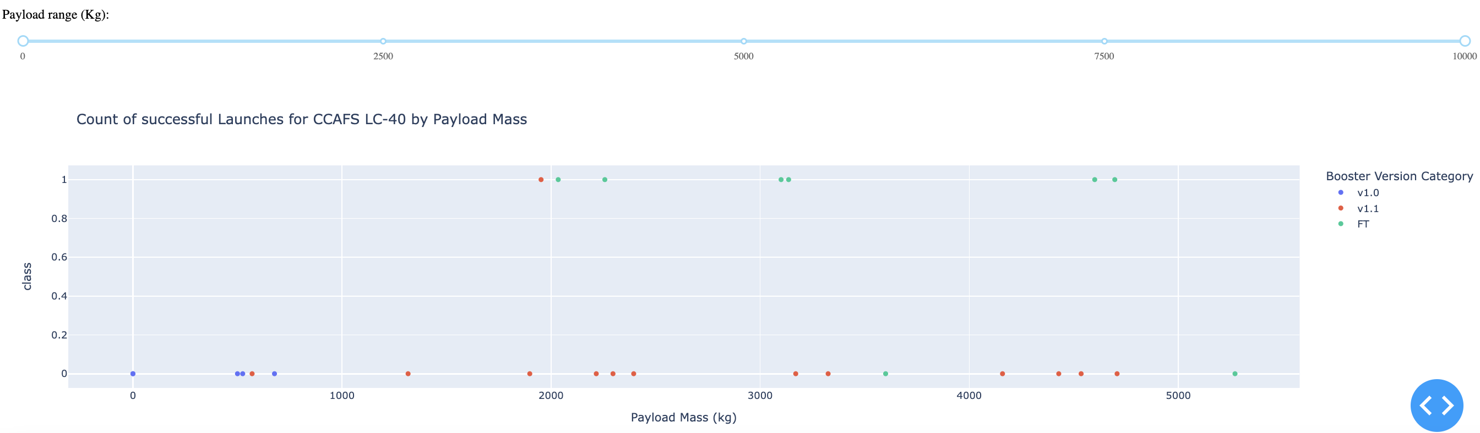
Count of Successful Launches by Payload Mass
It appears that Booster version v1.1 had the lowest success rate across all payload ranges while version FT had the highest success, especially between 2000kg and 5000kg

Slide 42

Section 5

Slide 43
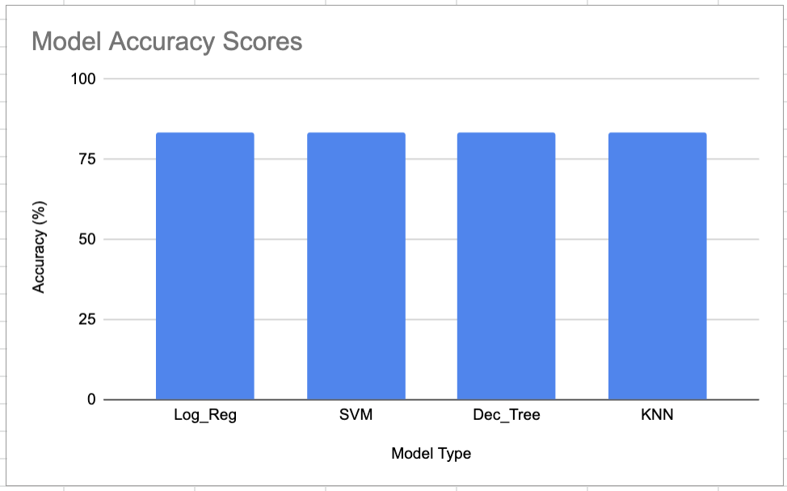
Classification Accuracy
All models resulted in similar accuracy scores of 83%

Slide 44
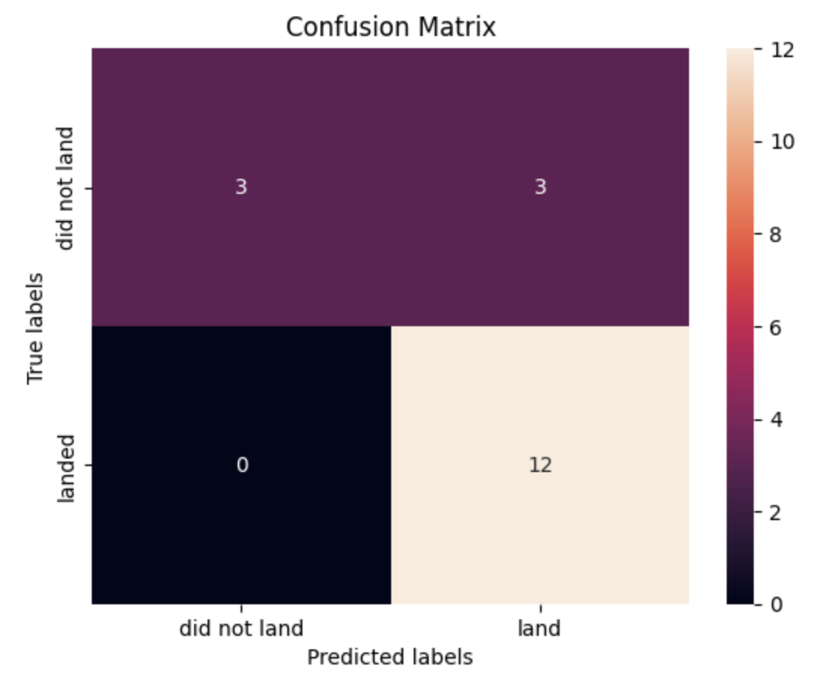
Confusion Matrix
The confusion matrix shows that of the 18 launches in the test set:
12 successful landing scenarios were accurately predicted
3 false positive predictions were made
3 accurate predictions were made for unsuccessful landings

Slide 45
Conclusions
Point 1
Point 2
Point 3
Point 4
…

Slide 46


